Slide 1
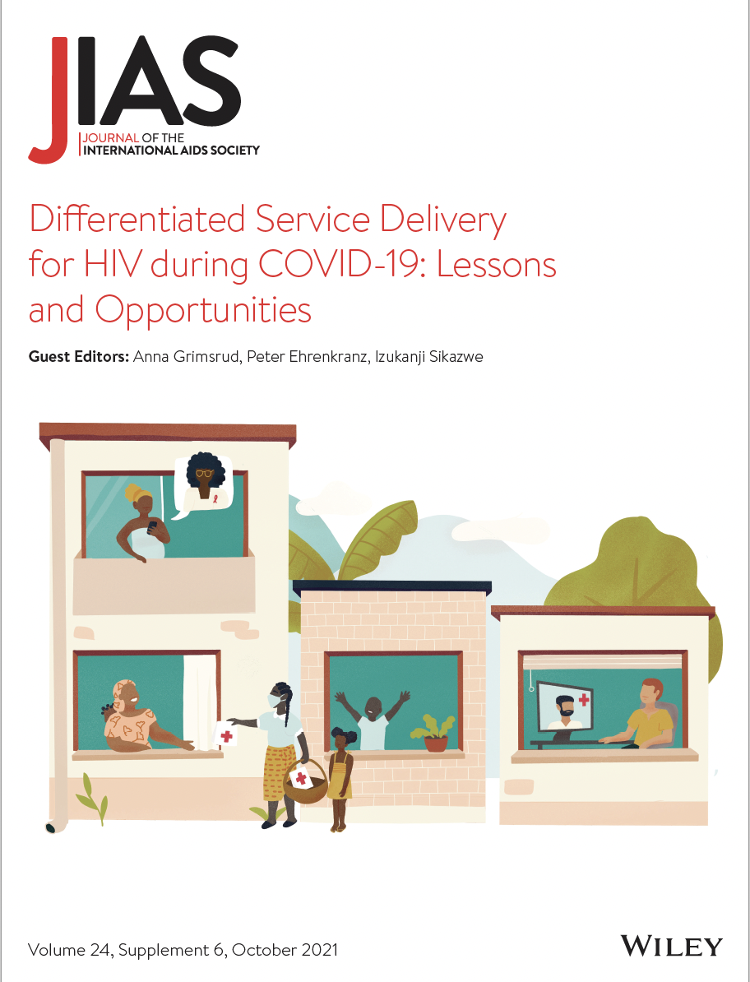
Differentiated service delivery for HIV during COVID-19: Lessons and opportunities Launch of the JIAS supplement
Anna Grimsrud, IAS – the International AIDS Society
Izukanji Sikazwe, Centre for Infectious Disease Research in Zambia (CIDRZ)

Slide 2
Today
Introduction and overview | Session moderators: Anna Grimsrud, IAS – International AIDS Society, South Africa & Izukanji Sikazwe, Centre for Infectious Disease Research in Zambia (CIDRZ), Zambia
Supporting PrEP access for female sex workers in Zimbabwe during COVID-19 lockdown with community-based delivery, extended PrEP refills and virtual support during COVID-19 lockdown | Primrose Matambanadzo, Centre for Sexual Health and HIV/AIDS Research (CeSHHAR), Zimbabwe
Changes in utilization of DSD for HIV treatment during COVID-19 in Zambia | Youngji Jo, Boston Medical Centre, USA and Bevis Phiri, Clinton Health Access Initiative (CHAI), Zambia
DSD for people on second-line antiretroviral therapy: Evidence from KwaZulu-Natal, South Africa | Jienchi Dorward, Centre for the AIDS Programme of Research in South Africa (CAPRISA), South Africa
Earlier referral to a community-based DSD for HIV treatment model with multi-month dispensing and annual clinic visits: Data from two cluster-randomized trials in Lesotho and Zimbabwe | Trish Muzenda, Kheth’Impilo AIDS Free Living and School of Public Health and Family Medicine, University of Cape Town, South Africa
Silver linings: How COVID-19 expedited differentiated service delivery for HIV | Peter Ehrenkranz, Bill & Melinda Gates Foundation (BMGF), USA
DISCUSSION | Authors and Nelson Otwoma, National Empowerment Network of People living with HIV/AIDS in Kenya (NEPHAK), Kenya

Slide 3
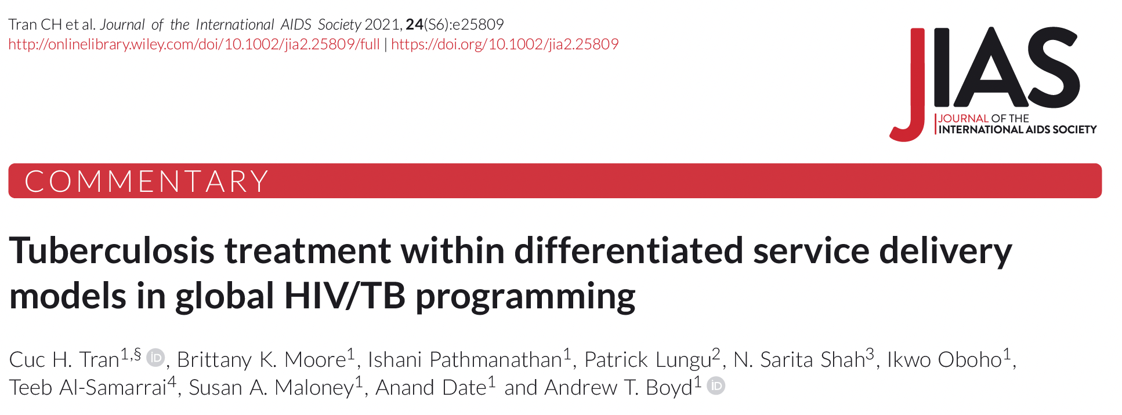

Slide 4
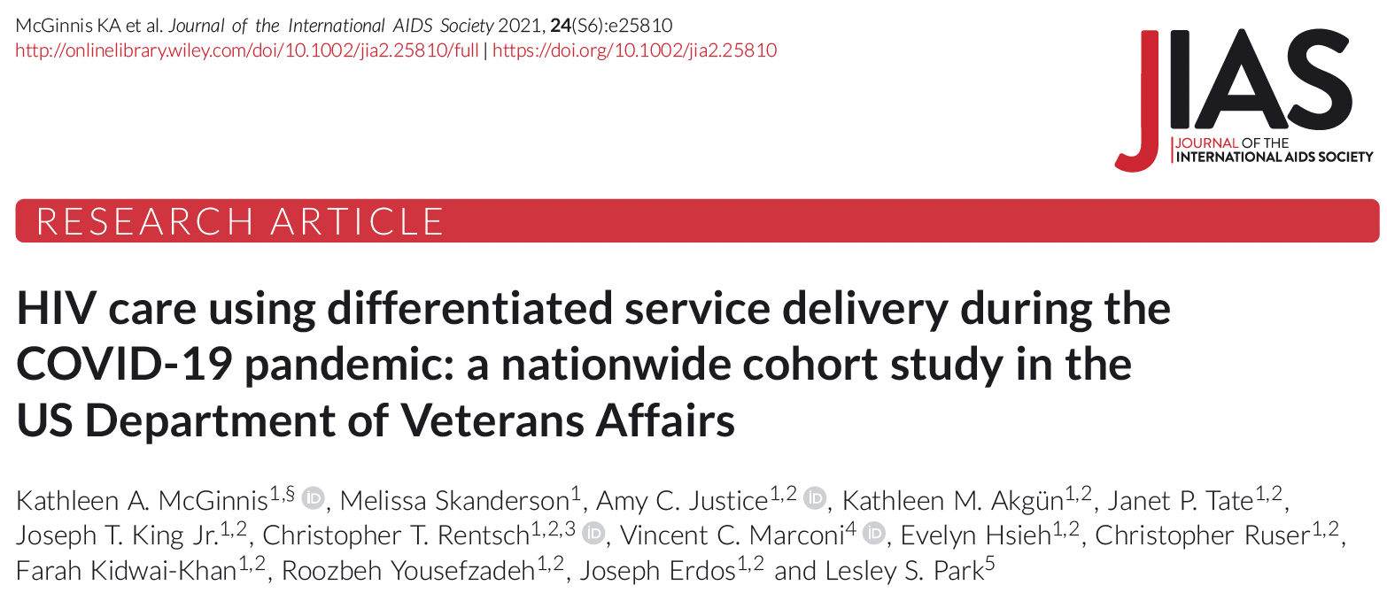
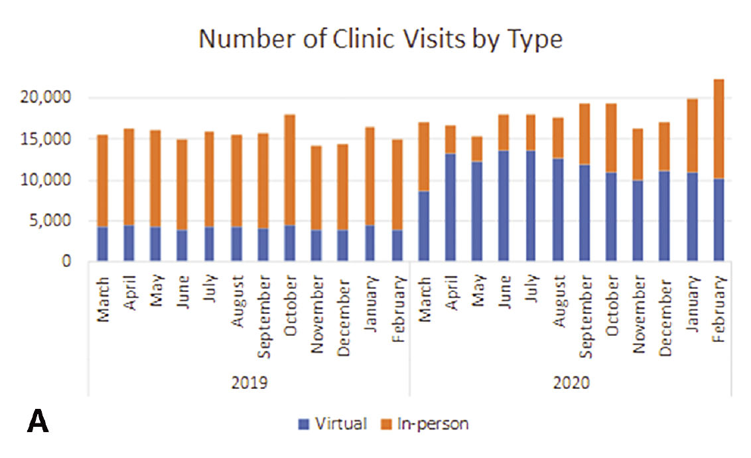
“During the COVID-19 pandemic, the VA increased the use of virtual visits and longer ARV refills, while maintaining a high percentage of patients with suppressed VL among those with VL measured. Despite decreased in-person services
during the pandemic, access to ARVs was not disrupted.”

Slide 5
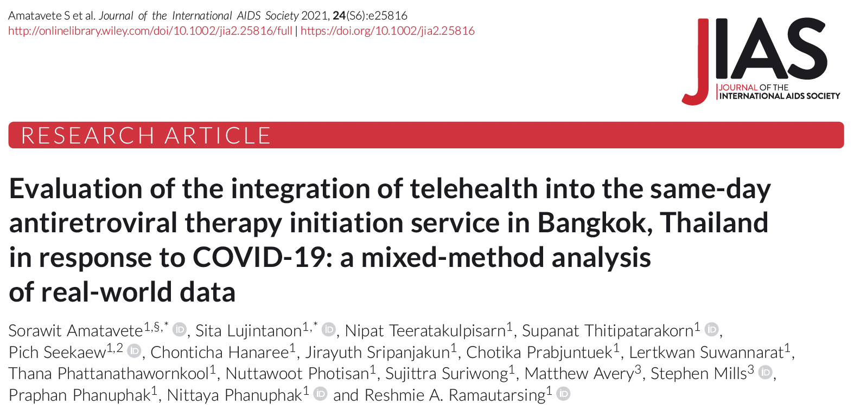
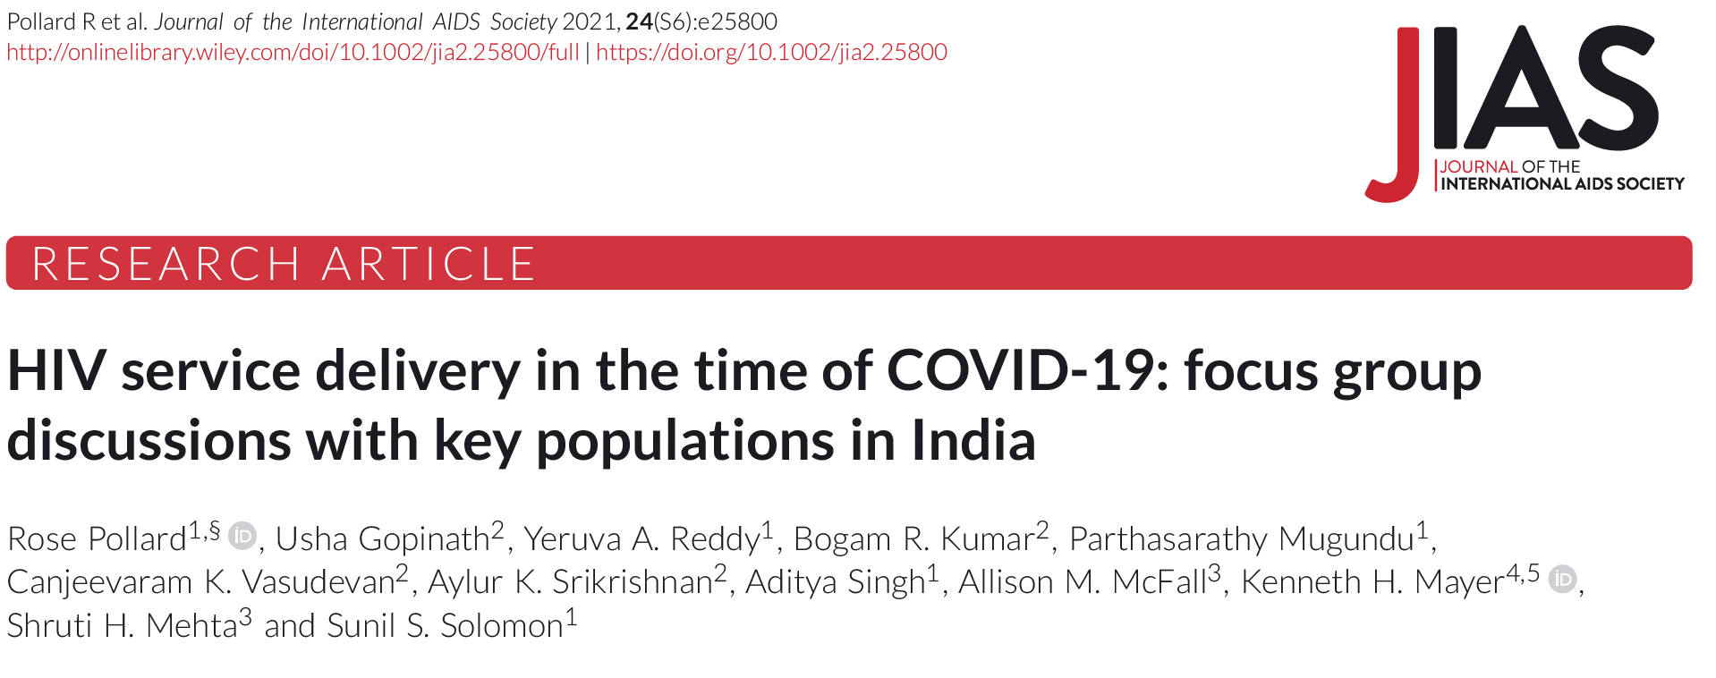
“We needed to find a way for clients to get their ART and receive the [medical services] as if they came to the clinic. This led to the [incorporation of] the telehealth follow-up via video call. We chose the technological tools that are widely available, which are smartphone and LINE application. If the clients could not do telehealth because they didn’t have a phone or internet, they could still come to the clinic, given how small the outbreak was in our country”. –
Physician 1
“We found that participants were appreciative of adaptations of the national AIDS program to ensure continuity of services, such as MMD and home/community-based ART delivery”

Slide 6
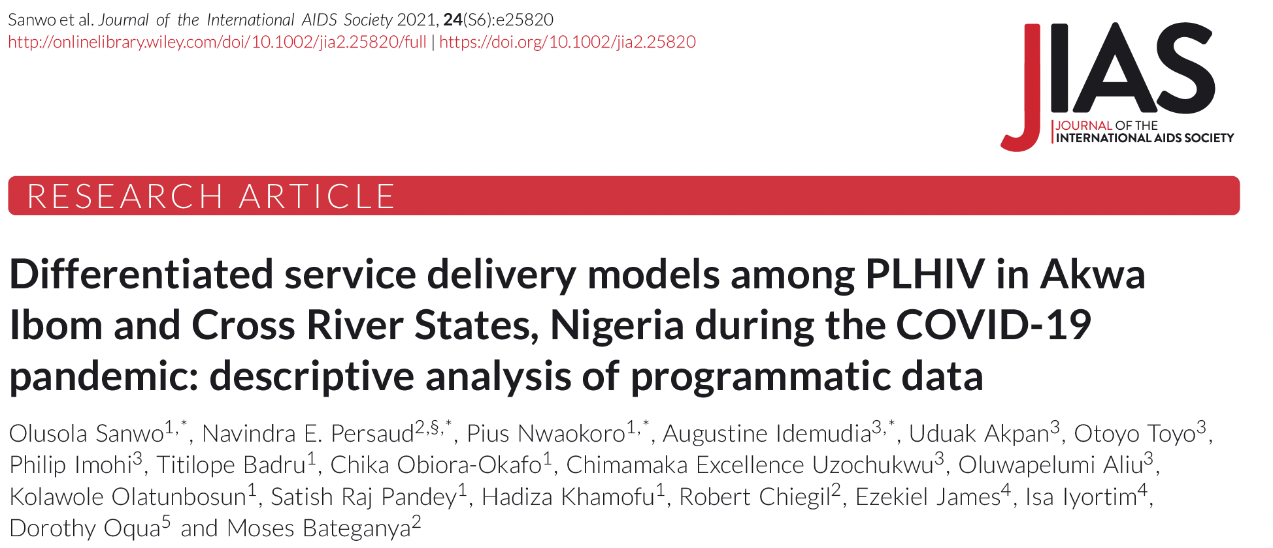
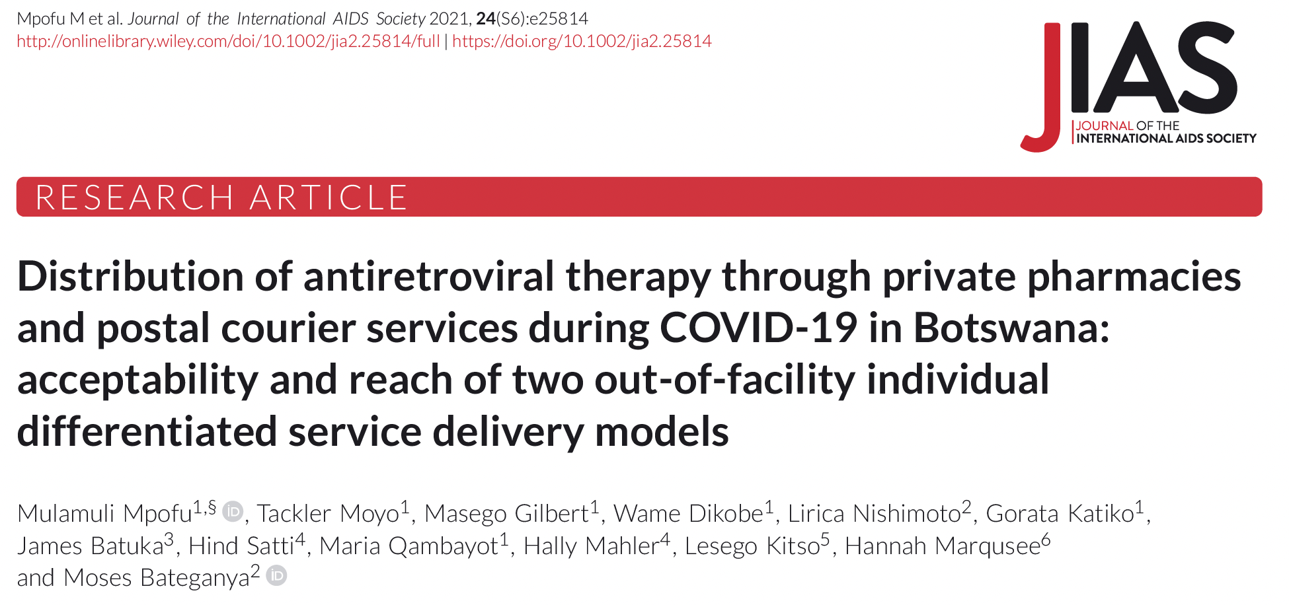
“The movement restrictions,
physical distancing requirements, supply chain disruptions and
financial difficulties brought on by the pandemic necessitated
the transitioning of patients to other models of care that
limit exposure of both patients and HCWs to COVID-19.”
“We found high interest and acceptability of the pharmacy and home delivery models in Botswana, demonstrating that these models could ensure treatment continuation in the context of COVID-19.”

Slide 7
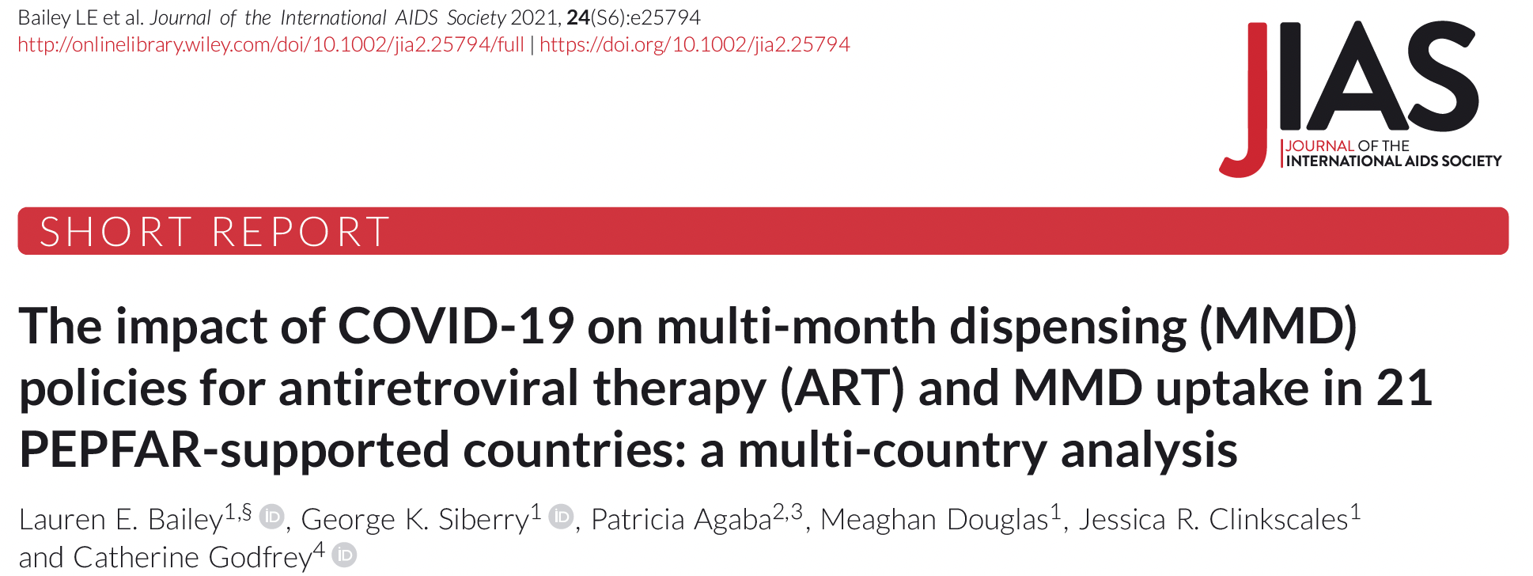
“The COVID-19 adaptations to MMD policy created an enabling environment for accelerating MMD uptake and extending dispensing intervals, particularly among clients < 15 years of age.”

Slide 8
Acknowledgements and support
We would like to thank all of the authors who responded to our request for contributions, prepared manuscripts, and participated in the rigorous review and selection process. We hope that this effort to compile the latest evidence and around how differentiated service delivery (DSD) for HIV has been adapted and accelerated in response to COVID-19 will encourage more science and further implementation.
This supplement was supported funding from the Bill & Melinda Gates Foundation. The content is solely the responsibility of the authors and does not necessarily represent the views of the funding agency.

