Slide 1
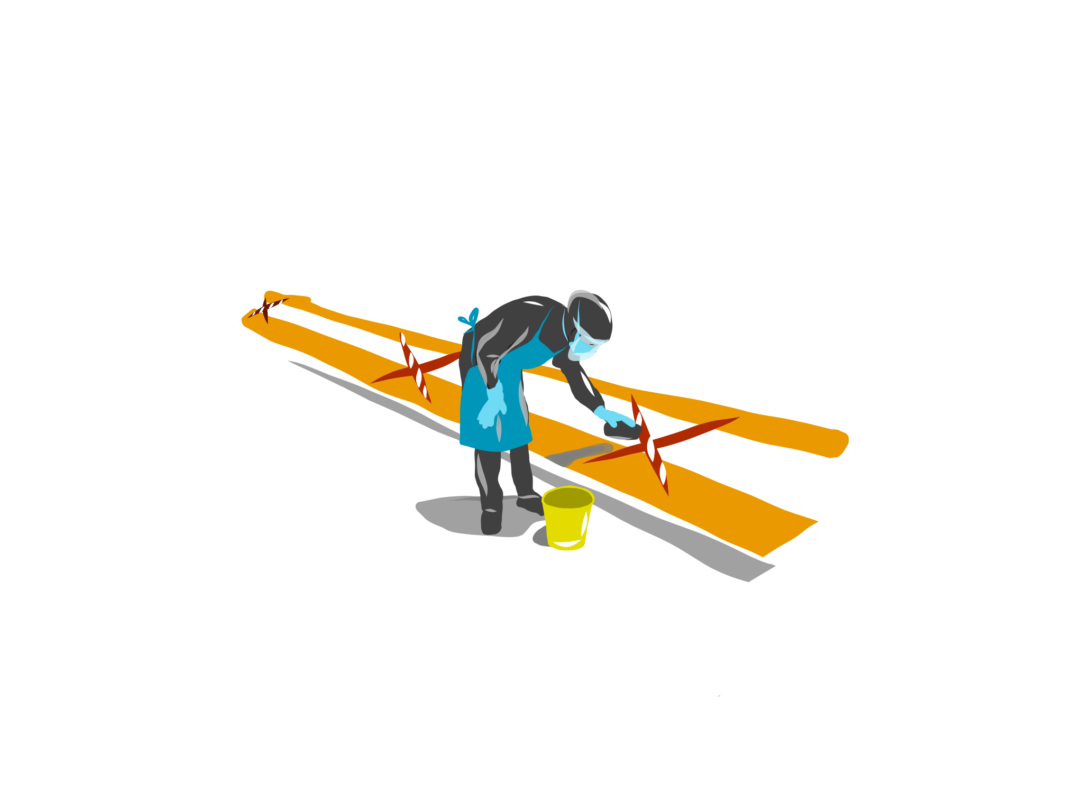
Critical
environmental
cleaning of health facilities
25 May 2020

Slide 2
10 essential components of facility set-up
Single point of entry to facility premises 1 | YELLOW ZONES
Patient and HCW sanitation station 2
First Screening Station 3
Second Screening & Management Station….. (also called Temporary Chest Clinic) 4 | ORANGE ZONES
HIV Testing Stations 5
Specialized clinical service station….. for COVID-19 symptom positive patients 6
COVID-19 and TB testing station 7
HCW sanitation station at entry to routine services 8 | BLUE ZONES
Routine services inside facility….. for COVID-19 symptom negative patients 9
Facility station transfer and exit pathways 10 | TAKE COLOUR FROM PREVIOUS STATION
COVID-19 medium risk
COVID-19 high risk
COVID-19 low risk + protected

Slide 3
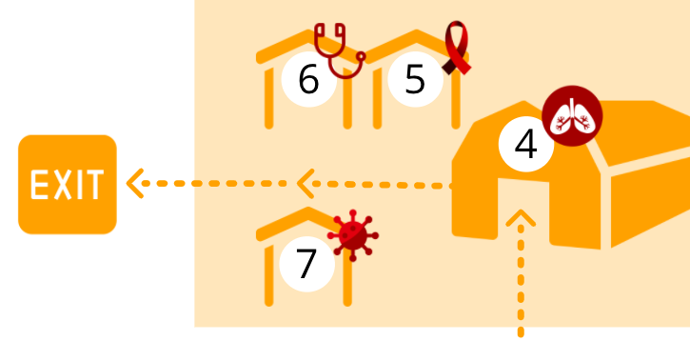
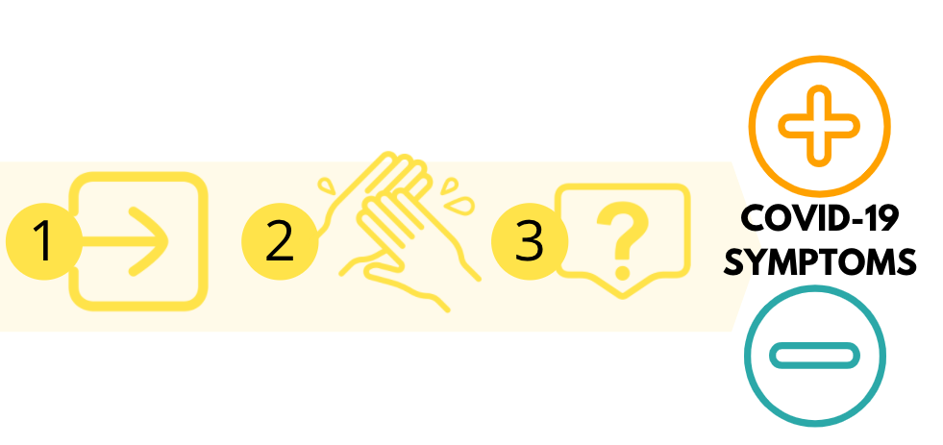
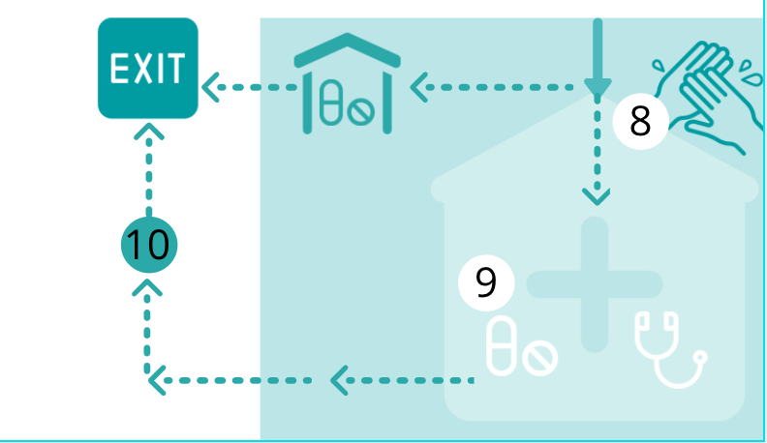
Appropriate cleaning critical to all stations
Al
Where environmental cleaning requirements NOT met increased infection risk despite good facility set up
STRICT ADHERENCE TO ENVIRONMENTAL CLEANING CRITICAL PART OF FACILITY CONTINUED READINESS

Slide 4
What is environmental cleaning?
Routine cleaning with water and detergent
Specific cleaning with water and detergent of visibly soiled areas
Wipe over cleaned area with disinfectant = 1:1000 ppm available chlorine
*National: COVID-19 Disease: Infection Prevention and Control Guidelines v1 – April 2020

Slide 5
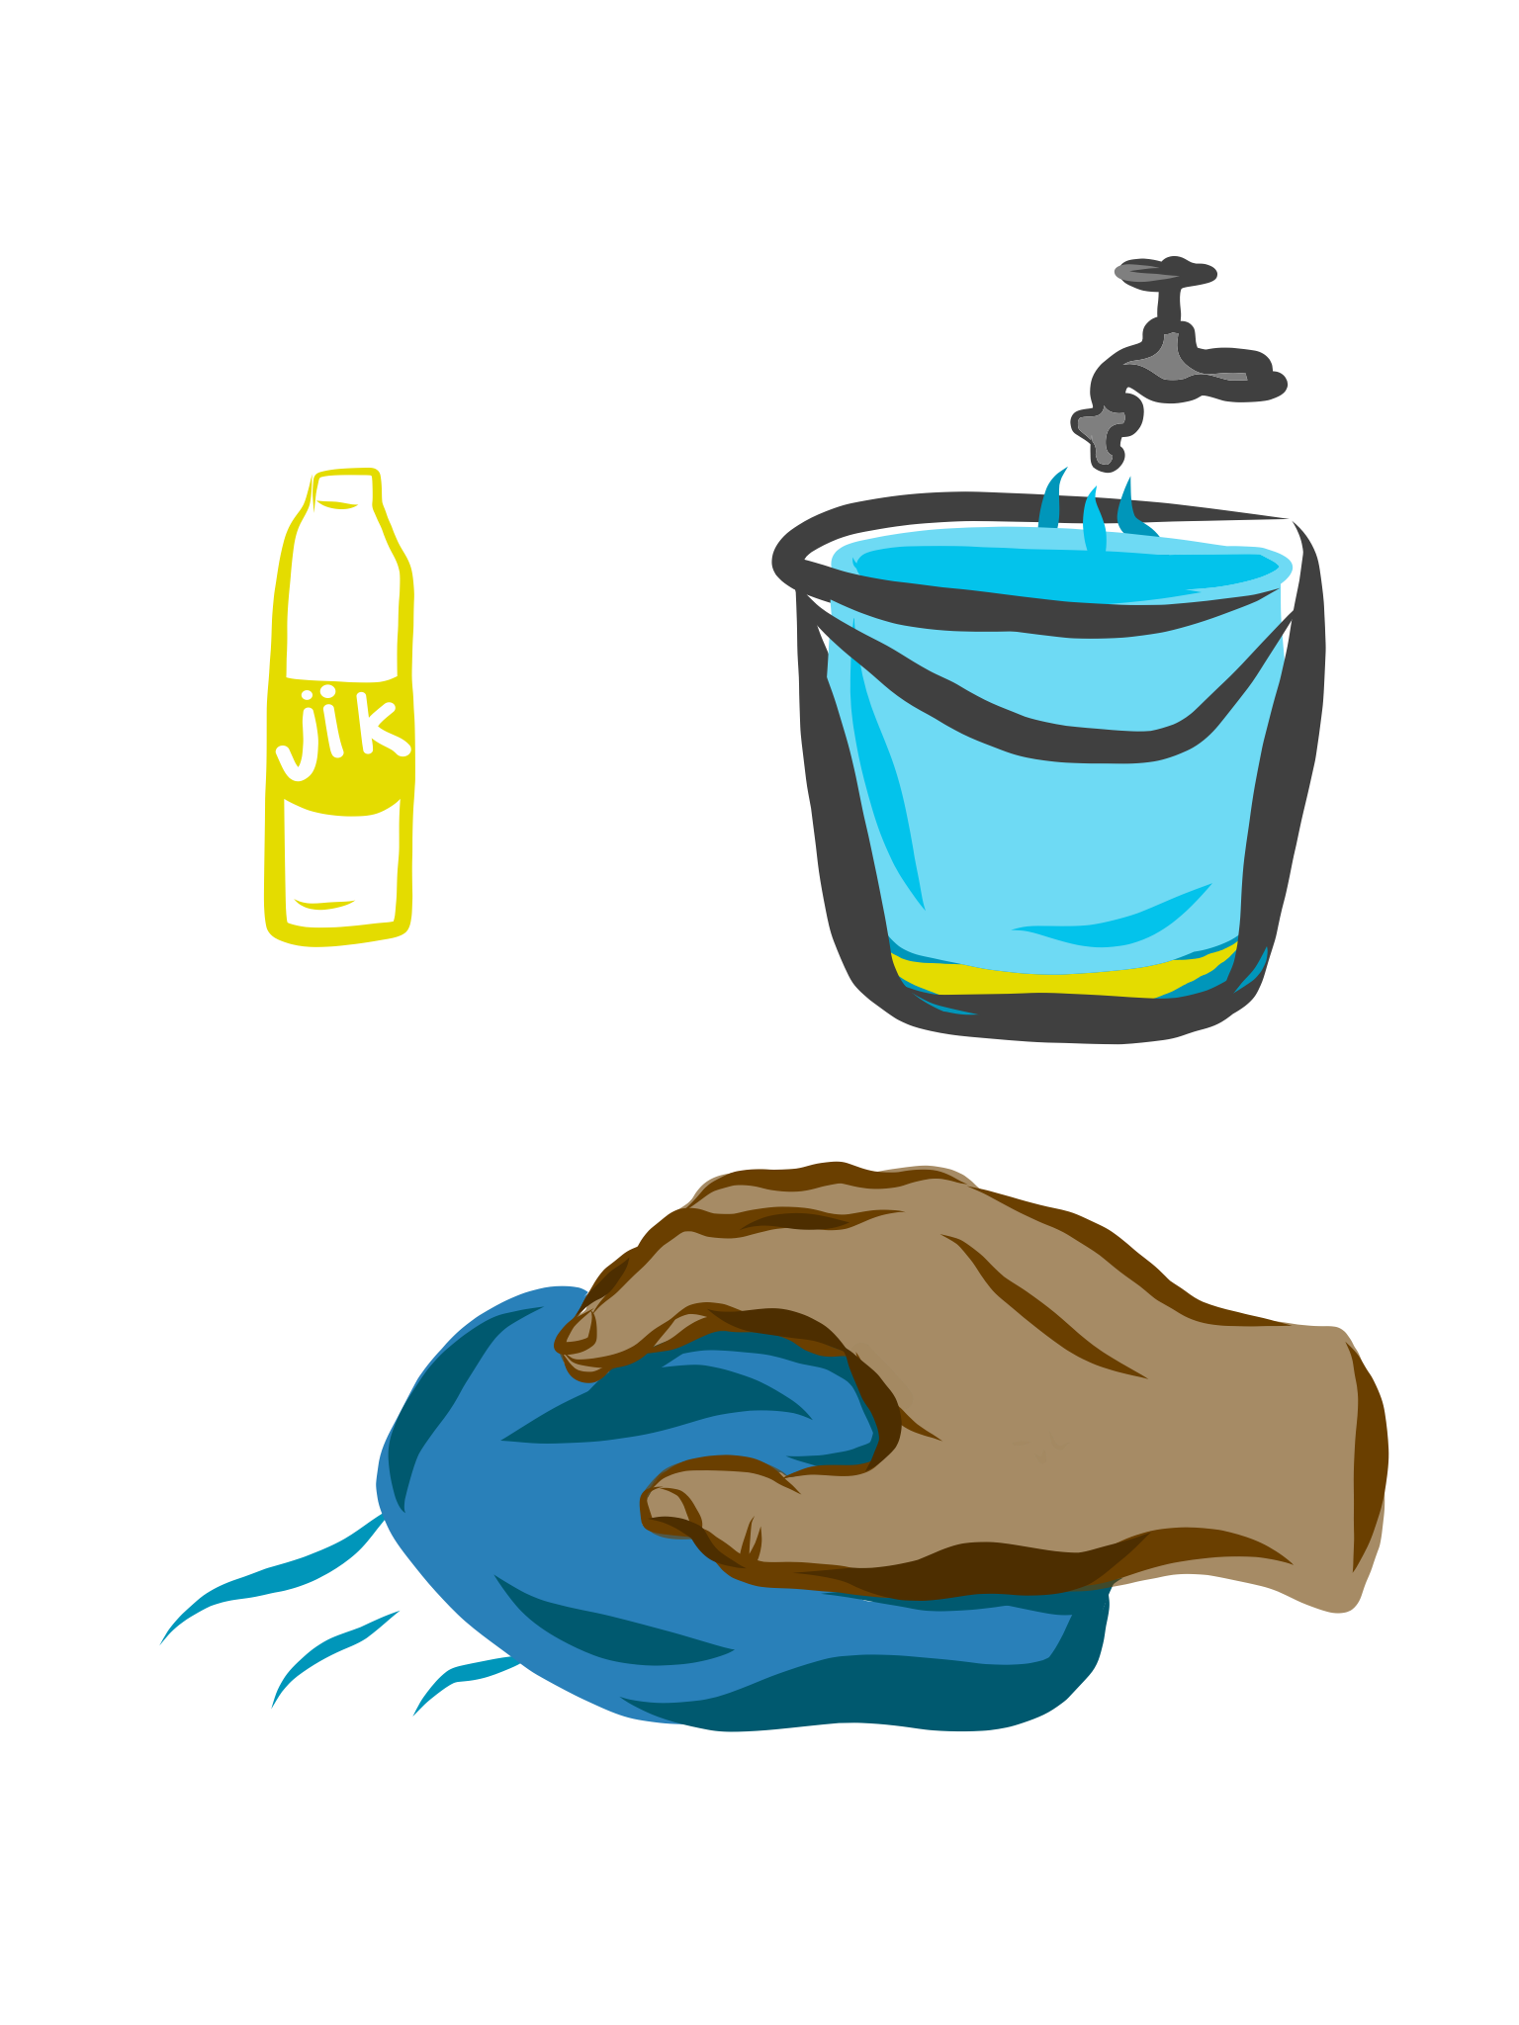
Bleach concentrations for disinfectant
 | 1000ppm | 5000ppm
Sodium hypochlorite (liquid bleach) 3,5% chlorine | 1 part bleach: 34 parts water (Add 30ml to 1 litre) | 1 part bleach: 6 parts water
Sodium hypochlorite (liquid bleach) 5% chlorine | 1 part bleach: 49 part water (Add 20ml to 1 litre) | 1 part bleach: 9 parts water
*National: COVID-19 Disease: Infection Prevention and Control Guidelines v1 – April 2020

Slide 6
Cleaning responsibilities of facility staff
Role of all HCW staff: clean the patient zone before and after rendering patients care
Role of administrative staff: clean the desk, telephone and electronic devices are use / every 30-60 minutes
Role of cleaning staff: routine and terminal cleaning of all areas
Role of IPC officer:
Monitoring and oversight of cleaning practises and appropriate use of detergents and disinfectant
Staff wearing PPE appropriately
Education and training
Ensure that hand sanitizer, disinfectant and paper towel available in all areas of facility
Ensure that PPE is available in all areas of facility

Slide 7
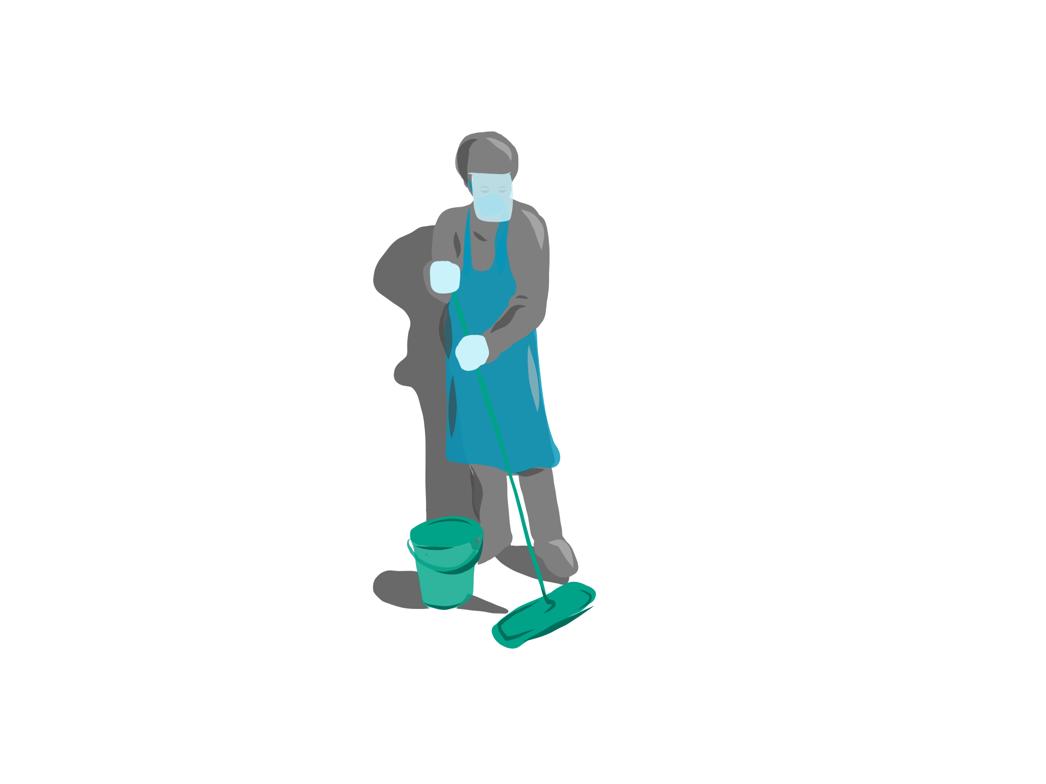
Overview of required cleaning practice
Facility environmental cleaning requires a proper schedule, checklist and program.
Each area of the health facility should be cleaned and disinfected at least twice daily
Disinfect frequently touched surfaces with disinfectant wipe/solution every 30 to 60 minutes depending on frequency of use
Clean and disinfect facility toilets every 3 hours.
High-risk areas (orange zone areas) should be cleaned and disinfected every 3 hours
*National: COVID-19 Disease: Infection Prevention and Control Guidelines v1 – April 2020

Slide 8
Types of waste – colour coding
Red – all microbiology laboratory wastes, waste from surgeries and autopsies and all contaminated waste produced during treatment of patients including used PPE
Yellow – sharps disposal
Black – general waste

Slide 9
Used PPE interim storage and disposal
Need robust container (usually a cardboard box) with red plastic bag (per specifications)
Filled no more than ¾ full
Securely closed at all times
Interim storage
tied up/cable tied closed and marked when full
stored away from general waste
in a locked area (persons and pests should not have access)
that is well ventilated
that is washable with a drainage point in the floor
that has proper lighting
that is equipped with spill kits
room to be marked with universal sign that signifies “bio-hazard”
door to be marked with a “no entry” sign

Slide 10
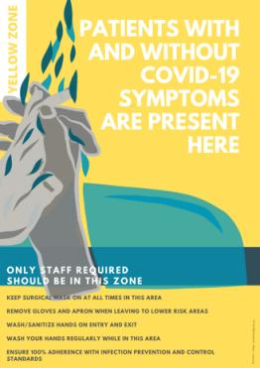
Everyone arriving at the facility passes through the
YELLOW ZONE
Notes:
Yellow Zone: Moderate COVID-19 risk zone – patients with COVID-19 symptoms have not been identified or separated out yet

Slide 11
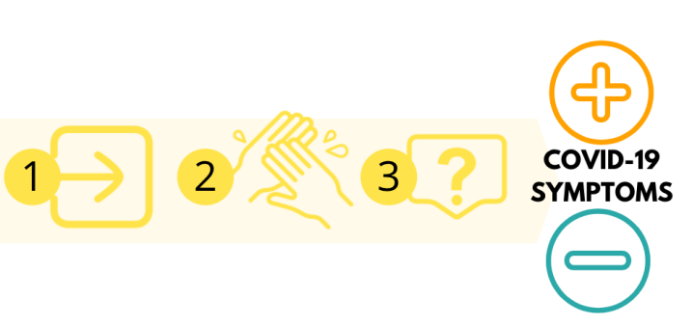
Yellow Zone

Slide 12
Cleaning requirements for yellow zone
Each area including security room, sanitation station and 1st screening station should be cleaned at least twice daily with a proper schedule, checklist and program.
Disinfect frequently touched surfaces with disinfectant wipe/solution every 30 to 60 minutes – wipe down door knobs, gate if opened and closed repeatedly
Clean and disinfect security staff toilets every 3 hours.

Slide 13
Cleaning responsibilities and supplies for yellow zone
Security staff responsible for environmental cleaning of security room, sanitation station and security toilet – including all chairs and tables in these areas.
Screeners responsible for cleaning and disinfecting their chair before and after shift and if using a table every 30-60 minutes
Buckets, spray bottles, cloths/paper towel, disinfectant to be supplied by facility and made available at all stations at all times for use.

Slide 14
Practical implementation tips
Set up a water container/bucket with tap and filled with correct concentration of bleach/water at central point in yellow zone for use by all staff in this area.
Provide spray bottles/buckets that can be filled with disinfectant concentraton from central point and cloths/disposable towels for wiping down surfaces after cleaning.
Provide a bucket and mop for central area for cleaning of toilet and any other visibly soiled area.

Slide 15
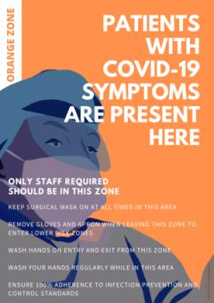
Patients with a POSITIVE SCREEN managed in
ORANGE ZONE
Notes:
High COVID-19 risk zone – patients with COVID-19 symptoms screened, assessment, managed and tested in this zone.

Slide 16
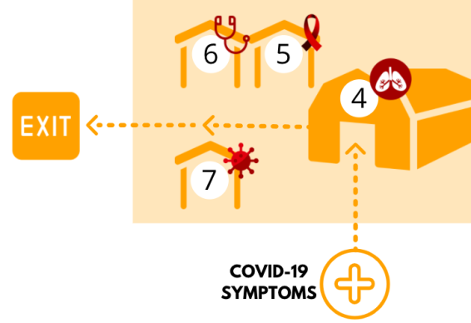
Orange Zone

Slide 17
Cleaning requirements for orange zone
Each area including 2nd screening and assessment station (temporary chest clinic), HIV station, specialized clinician station, COVID-19 test form completion and COVID-19 donning/doffing and specimen collation area plus all waiting spaces to be cleaned every 3 hours with a proper schedule, checklist and program.
All chairs in the Orange Zone must be disinfected between use by each patient
Easiest strategy is to allocate a chair to patient on arrival – moves with the patient through Orange Zone including testing and is disinfected once patient leaves to exit facility for re-use.
COVID-19 screening station needs to be disinfected between each patient tested – this includes all surfaces
Easiest to only use patient chair and no other surfaces in testing area to limit need for disinfection. Locate specimen collation/donning and doffing in distanced area/fully screened off.
Toilets in the Orange Zone need to be cleaned and disinfected between use by each patient.
Isolation room in Emergency department and MOU should be fully cleaned and disinfected between every patient managed in these rooms including any patient trolley/wheelchair used.

Slide 18
Cleaning responsibilities and supplies for orange zone
Orange Zone clinician to disinfect medical equipment (oximeter/BP cuff etc) after use for each patient and table between every patient.
COVID-19 tester to ensure disinfection of testing area/donning and doffing area and COVID-19 specimen collation area.
COVID-19 form completers to disinfect their table between every patient – wipe it down alternatively only use clipboards
Runners/Orange Zone cleaner to disinfect chairs and toilet after use by each patient.
Buckets, spray bottles, cloths/paper towel, disinfectant to be supplied by facility and made available at all stations at all times for use.

Slide 19
Waste management from orange zone
Need robust containers (usually a cardboard box) with red plastic bag inside (per specifications)
Filled no more than ¾ full
Securely closed at all times – not left open overnight!
Red plastic bags to be cable tied closed when full or end of day and marked “Orange Zone waste’ and is to be taken to the facility’s health care waste management central storage area.
Sharps waste should be discarded into the designated yellow sharps containers, sealed when such container is three quarters full and marked “Orange Zone Sharps” to be taken to the facility’s health care waste management central storage area.

Slide 20
Practical implementation tips
Set up a water container/bucket with tap and filled with correct concentration of bleach/water at central point in orange zone for use by all staff in this area.
Provide a bucket and mop for central area for cleaning of toilet and any other visibly soiled area
Provide spray bottles/buckets that can be filled with disinfectant concentraton from central point and cloths/disposable towels for wiping down surfaces after cleaning.

Slide 21
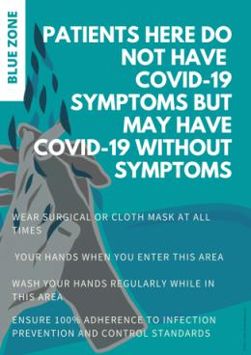
Patients with a NEGATIVE SCREEN managed in the
BLUE ZONE
Notes:
Low COVID-19 risk zone – patients without COVID-19 symptoms (but may be asymptomatic) managed in this zone.

Slide 22
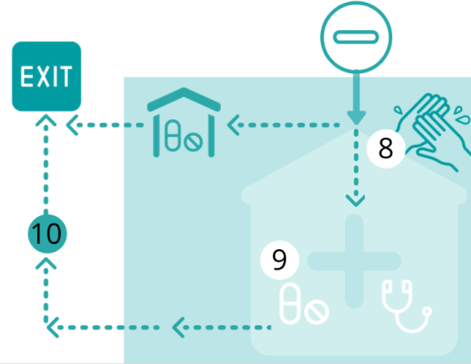
Blue Zone

Slide 23
Cleaning requirements for blue zone
Each area including all waiting areas, all consulting rooms, pharmacy, registry should be environmentally cleaned at least twice daily with a proper schedule, checklist and program.
Disinfect frequently touched surfaces with disinfectant wipe/solution every 30 to 60 minutes – door knob and counters
Vital station to ensure disinfection of medical equipment – oximeter and BP cuff between each patient
Chairs used by patients should be disinfected after every patient use
Easiest to use numbering waiting systems to make disinfection less frequent and more feasible.
Clean and disinfect toilets every 3 hours.

Slide 24
Cleaning responsibilities and supplies for blue zone
HCW staff in each area responsible for disinfection of chairs, tables, medical equipment and other frequently touched surfaces within their service.
Cleaners responsible for environmental cleaning of floors, toilets, high touch surfaces and other routinely cleaned areas of the facility.
Buckets, spray bottles, cloths/paper towel, disinfectant to be supplied by facility to each service area of the facility and available at all times for use.

Slide 25
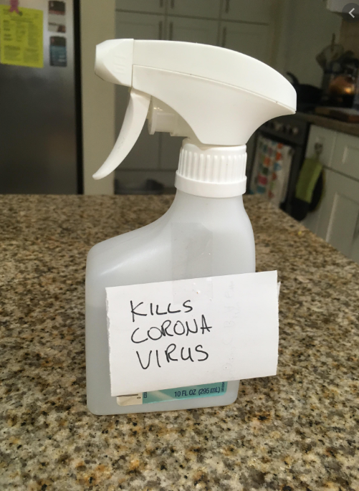
Practical implementation tips
Provide spray bottles/buckets that can be refilled with disinfectant concentraton each day and cloths/disposable towels for wiping down surfaces.
Ensure each service/area within facility has a visible spray bottle/bucket of disinfectant with cloth to be easily access and used!
Provide a bucket and mop for each area of the facility for cleaning visibly soiled area

Slide 26
Terminal/Deep cleaning
Terminal cleaning is a complete and enhanced cleaning procedure that decontaminates an area following discharge or transfer of a patient with an infectious/communicable disease, sometimes also referred to as a ‘deep clean’.
Terminal cleaning requires both thorough cleaning and disinfection for environmental decontamination.
Terminal clean only required of any patient trolley/wheelchair/bed area including emergency isolation room/MOU delivery room occupied by a patient confirmed with COVID-19 following discharge or transfer of the patient or later once case confirmed.

Slide 27
Process for terminal clean
Don appropriate PPE
Remove and discard all unused consumables and personal equipment (PPE) from the room
Remove all linen in the room
Remove all waste from the room
Remove all medical equipment and items used by patients from the space (drip stands, etc)
Wash all surfaces, furniture and fittings (walls to height of 2m /partitioning to hand height, gabbler rails, etc.) with detergent
Clean all surfaces of bed and mattress (including bed frames, mattress, pillows and wheels (carbolize the bed)
Mop the floor
All the above surfaces must then be disinfected with a chlorine based or hypochlorite solution 1000ppm (e.g. 4 sachets of biocide 6g packet to 9L of water or 70% alcohol surface disinfectant) to complete the terminal/deep clean
Ensure that all used medical equipment is appropriately cleaned and stored
Cleaning of string mops must be done with e.g. Paragon and then biocide before storing
Ensure that the room/space is dry before the next patient is admitted

Slide 28
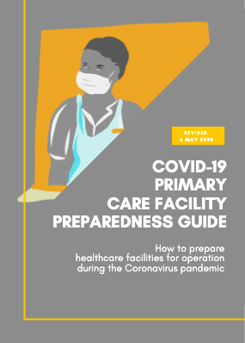
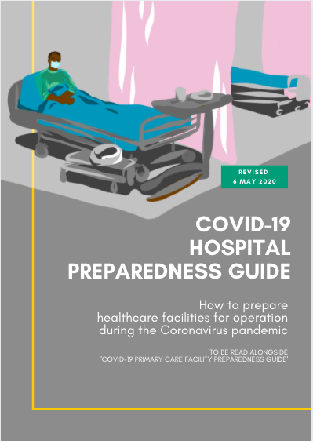
Thank you & stay safe

Slide 29
Acknowledgements
Lynne Wilkinson (International AIDS Society)
Tom Boyles (Anova/Helen Joseph Hospital)
Jean Elphick (illustration and design)

